Slide 1
Chapter 12, 13
How to add audio and video to your web site
and
How to format web pages for printing
Notes:
Session: Ghi số thứ tự session trong môn học
Session Name: ghi tên của session sẽ dạy
<number>

Slide 2
Objectives
An introduction to media on the web
How to add audio and video to a web page
How to embed fonts in a web page
The skills for formatting printed web pages
A two-column web page
with special formatting for printing
Notes:
Mô tả nội dung mà học viên phải đạt được khi kết thúc môn học này
<number>

Slide 3
An introduction to media on the web

Slide 4
Common media types for video and audio
A media type is a container for several components, including an encoded video track, one or more encoded audio tracks, and metadata.
Notes:
Mô tả nội dung chi tiết từng chuyên đề
<number>

Slide 5
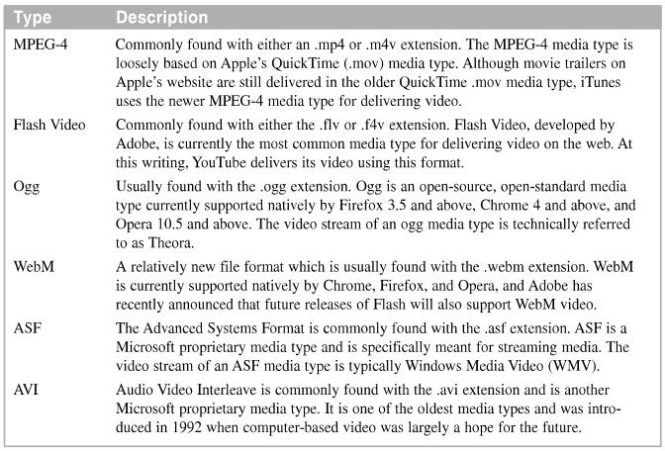
Common media type for video

Slide 6
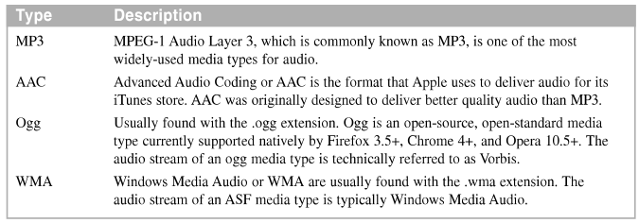
Common media types for audio
Notes:
Mô tả nội dung chi tiết từng chuyên đề
<number>

Slide 7
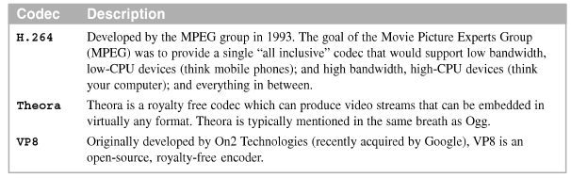
Video codecs
A codec (derived from Compressor or Coder/DeCoder) is a software component that is used to code and decode the algorithms that are used for a media type.
Video codecs

Slide 8
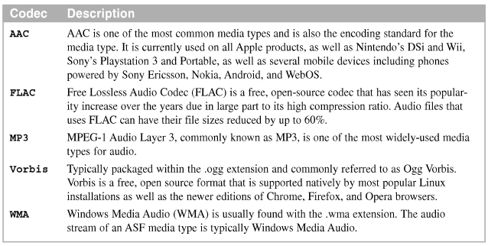
Audio codecs
An audio codecs is used to decode the audio portion of an audio or video file, convert it to audible waveforms, and send its to the speakers of a system.

Slide 9
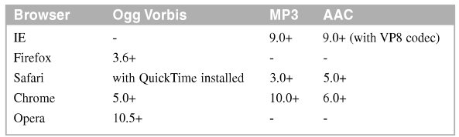
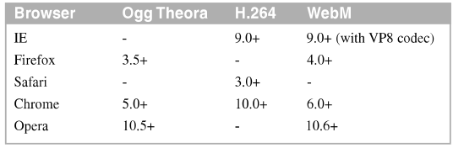
Audio and video support in current browsers
Audio codec support in current browser
Video codec support in current browsers

Slide 10
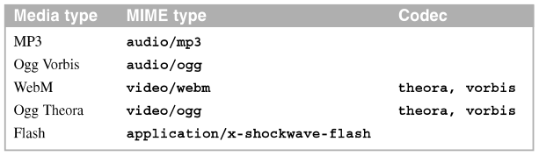
The MIME types to identify for audio and video files

Slide 11
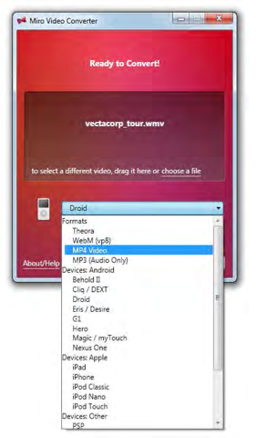
How to encode media
We can used the many encoders like: Miro Converter, iTunes, QuickTime, Windows Media Encoder, Adobe Media Encoder, firefogg, FFmpeg, and Handbrake

Slide 12
How to add audio and video to a web page

Slide 13
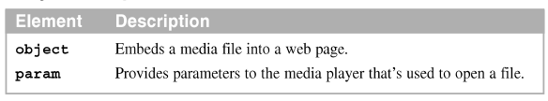
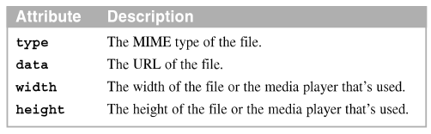
How to use the object and param elements
The object and param elements
Attributes of the object element

Slide 14
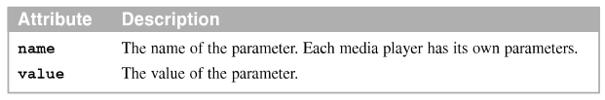

How to use the object and param elements
Attributes of the param element
An object element for playing a Flash file

Slide 15
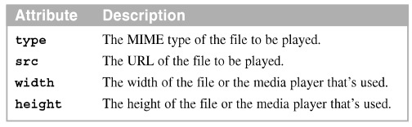
How to use the embed element
Embed element supported by all major browsers and now it is included in the HTML5
Attributes of the embed element

Slide 16

How to use the embed element
An embed element that plays a Youtube video

Slide 17
How to use the HTML5 video and audio elements
The video and audio elements play the various media type natively within the browser.

Slide 18
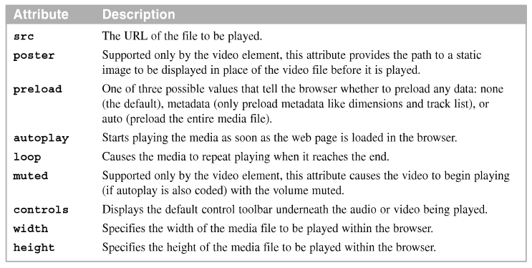
The common attributes for the audio and video elements

Slide 19
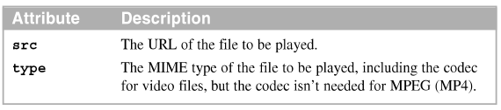
The attributes for the source elements
Example

Slide 20
How to fall back to Flash for backward compatibility
For browsers that don’t support the video and audio elements, you can nest an object elements within the video or audio elements to play a Flash file

Slide 21
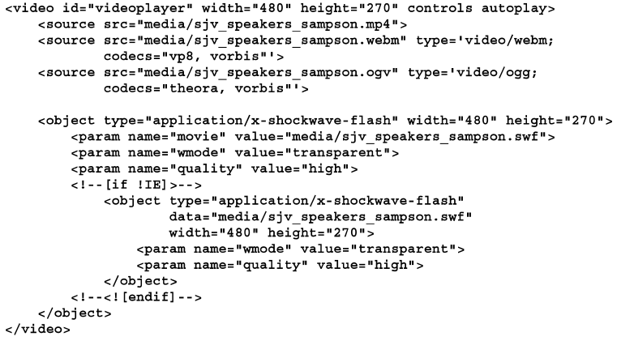
Example

Slide 22
A web page that offers both audio and video

Slide 23
The page layout
Web page offers both audio and video to the user. The audio is a brief introduction to the speakers. The video is a video of the selected speaker.

Slide 24
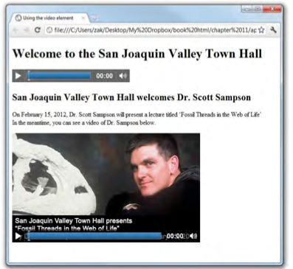
A web page that offers both audio and video

Slide 25
How to embed fonts in a web page

Slide 26
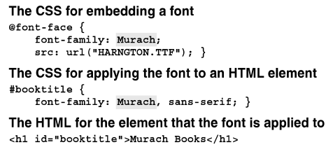
How to use the CSS3 @font-face selector to embed fonts
CSS3 provides a @font-face selector that can be used to import a font family
Example
A heading that uses a font imported with CSS3
Notes:
Mô tả nội dung chi tiết từng chuyên đề
<number>

Slide 27
How to use the CSS3 @font-face selector to embed fonts
Where to find the fonts on your computer
On a Windows system
C:\Windows\Fonts
On a Mac OS system
System\Library\Fonts

Slide 28
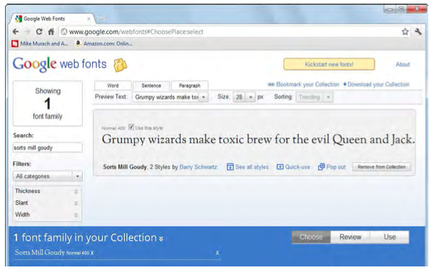
How to use Google Web Fonts
Google Web Fonts is a free Google service that lets you select and use any of the fonts in their current collection of 263 font families
The Google Web Fonts page

Slide 29
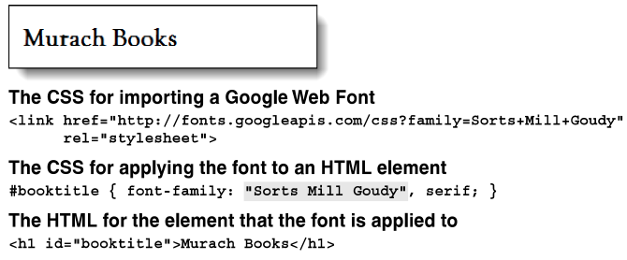
How to use Google Web Fonts
How to select Google Web Fonts
How to apply the imported font to an HTML element
A heading that uses a Google Web Font

Slide 30
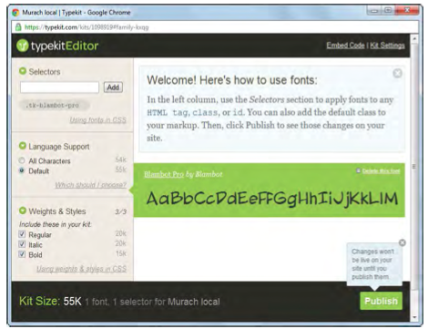
Other options for embedding fonts
Adobe Typekit is an Adobe service that lets you select and use any of their fonts
The Typekit Editor web page

Slide 31
Other options for embedding fonts
To select Typekit fonts
To apply the imported font to an HTML element
The Script elements for importing Typekit fonts
The HTML for an element that a font is applied

Slide 32
The skills for formatting printed web pages

Slide 33
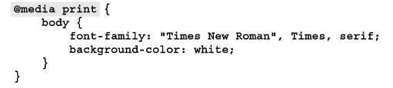
How to define the style sheets and rule sets for printed pages
Links elements that include style sheets for screen and print media
A rule set for printing that’s embedded within a screen style sheet

Slide 34

A style element for printing in the head section of the HTML

Slide 35
CSS properties for printed pages
Recommendations for formatting printed pages
Change the text color to black and the background color to white
Change text other than headings to a serif font to make the text easier to read when printed
Use a base font size that’s easy to read when printed
Remove site navigation since it can’t be used from a printed
Remove as many images as possible, particularly Flash and animated image

Slide 36
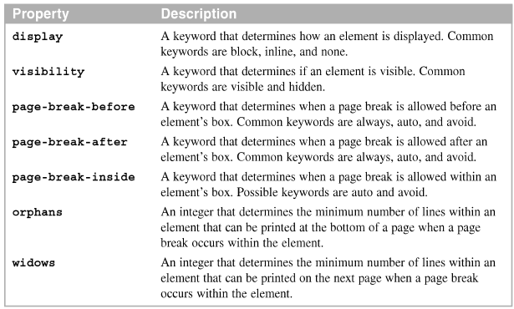
CSS properties for printing

Slide 37
A two-column web page with special formatting for printing

Slide 38
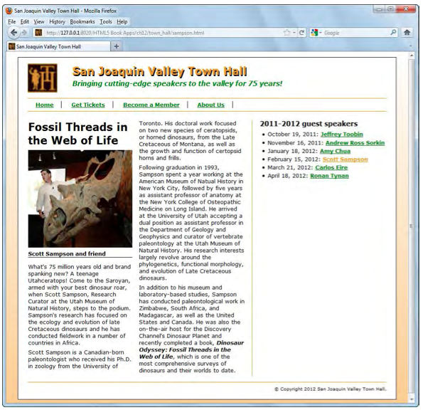
The links to the style sheets
A web page two columns

Slide 39
The link elements in the head section

Slide 40
The printed page
Changes to the printed page
The navigation bar and aside aren’t printed
The headings, text, and borders are set to black
The width of the article is wider and the right border is removed
The font for the text has been changed to serif font so it’s easier to read

Slide 41
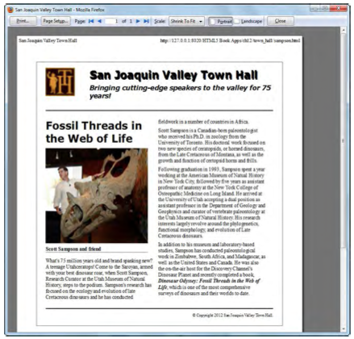
The layout for the web page in Print Preview mode

Slide 42
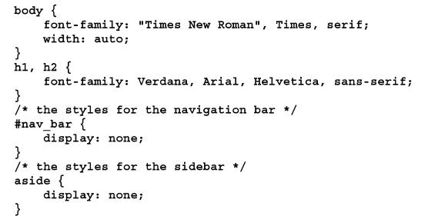
The CSS for the print style sheet
All of the rules in the print style sheet override the settings in the style sheet for the screen.
The CSS for the printed web page
……………..

Slide 43
Summary
Use media player to play an audio and video media type
Codecs are software components
A MIME type describes the contents of a file and can help a browser determine
Embed media types in the web page
Screen style sheets the style in the print style sheet will override the screen style
CSS provides several properties for printing, including the display property
Notes:
Tóm tắt lại nội dung đã học
<number>

Slide 44
Discussion
Notes:
Trả lời câu hỏi WHY?
<number>

